Slide 1
Bus Open Data
Bus Open Data Discovery
June 2018
M Nayyar, W Goodall

Slide 2

Context & objectives

Slide 3
Bus Open Data Discovery
Context of Discovery
What we were tasked to do:
“This discovery project aims to identify and investigate the users and their needs for this central hub. Elements of the hub have already been identified during preparation for the Bus Services Act, such as real time information. Other elements of the hub, such as the final solution architecture, would need to be defined by the user needs identified by this piece of work. This should result in a short report of findings, and a catalogue of user stories which can then be used to influence project and policy decisions”
Bus Open Data Discovery Request for Proposal document
We aimed to engage with the stakeholder community, conduct user research and analyse the findings to help inform a decision about the solution approach and high-level architecture.
From the early stages of the Discovery phase, we adopted a wider definition for the open data hub, with the options ranging from a centralised model to a distributed model.

Slide 4
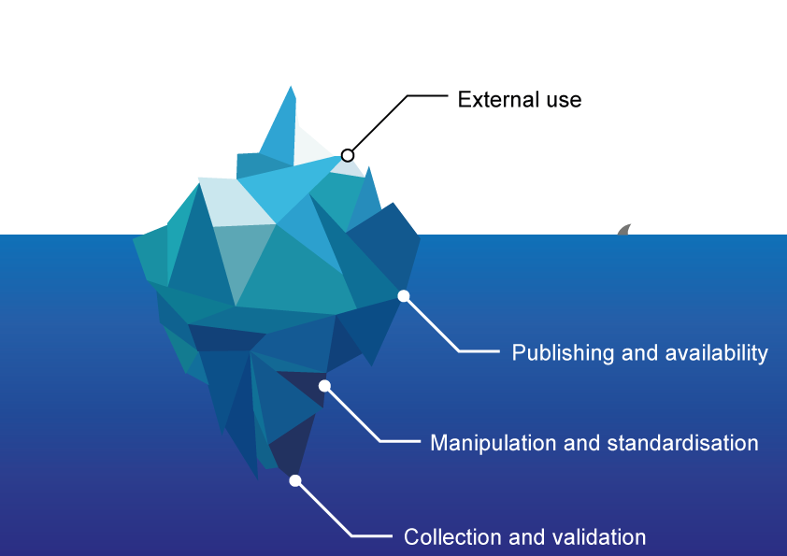
Pre-publishing data processes
Good open data requires good data practices below the surface.
The data iceberg diagram:
Publishing good quality open data requires good data processes and practices across the whole lifecycle of data.
Examining the issues and challenges of open data requires evaluating the end-to-end data lifecycle.

Slide 5
Beyond technical requirements
Good quality open data requires more than just a technical approach.
From our experience we recognise that the availability of good quality, usable open data that maximises value for end users and industry requires more than just a technical solution.
For any open data initiative to be successful, we need to consider a range of other factors, including;
Technical approach – how data is collected, managed and made open.
Business case and incentives – why should organisations publish data.
Governance and policy – who is responsible for encouraging and regulating open data publication.
Data skills and literacy – what skills are required.
Innovation – how is innovation encouraged.
Culture – how the industry understands the opportunities arising from being open.
Each of these factors impacts the uptake of open data initiatives, and without considering all of them initiatives are likely to face challenges in maximising use and value from open data.

Slide 6
Methodology & approach

Slide 7
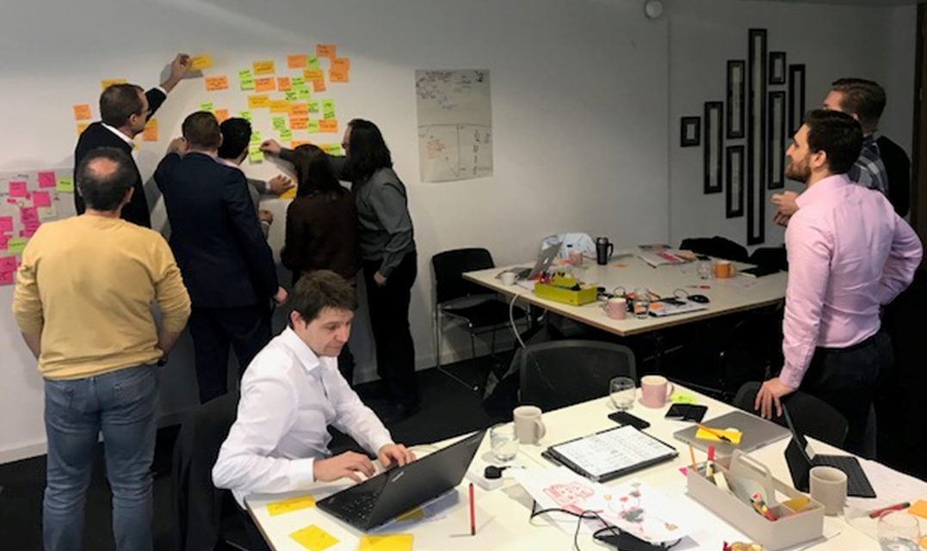
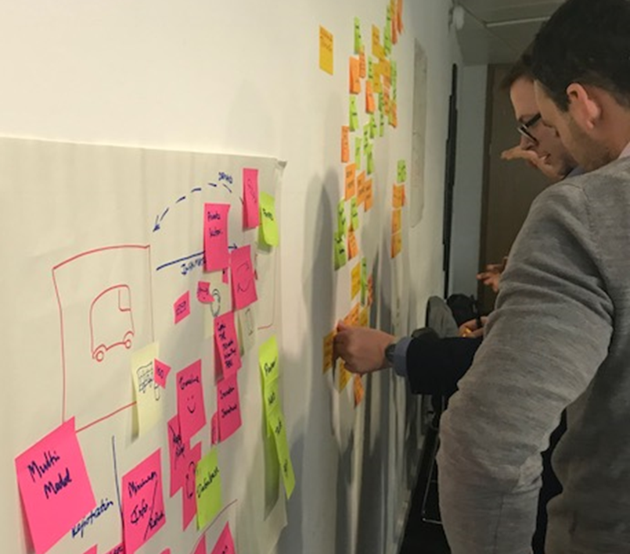
Methodology and Approach
We focused on process, people and technology to understand the bus sector data eco-system
Our experience and the lessons learned from open data exemplars from other sectors and countries showed us that the problem is not just lack of standards, and the solution is not only a technical platform.
We reviewed people, processes and technologies. We conducted desk research and analysed the full set of processes by which that data is generated, transformed and published.
We used Contextual Inquiry and Interviews to understand the stakeholders’ perspectives, motivation and needs.
We also analysed open data strategies and solutions from other industries and other locations.
Stakeholder Workshop
London
“
It is the first time that we meet with anyone from DfT. Seeing that DfT is actively trying to progress open data is a great news
Manager, Demand Responsive Transport operator
“

Slide 8
Findings

Slide 9
Findings – Themes overview
We have identified 8 themes to portray the current state of bus data
  Inconsistency in standards and processes- Ineffective or loosely defined data standards undermine the quality of the data available.
  Cumbersome distribution and publishing model- The current publishing model has a few layers in the data chain that do not add value, delay the publication and are prone to errors.
  Missing or ineffective data standards- Some data standards, such as fares and disruption information, are missing and operators are in need of clarity around best-practice data requirements.
  BSR and EBSR hinder open data distribution- EBSR adoption is unlikely to improve open data. Bus Service Registration process is conflated with good-practice data publishing.
  Current incentives do not promote good quality data- Incentives are often misaligned with providing good quality data, or simply missing.
  Bus sector is willing to cooperate- Existing cooperation between operators and LAs are common and in a number of cases enabled improved services to customers.
  Data opportunities are not grasped- Data is not seen as a business opportunity, and digital capabilities are rather weak.
  Bus sector is not keeping up with technology- The industry is not future-proofed and new digital-focused competitors are filling the gaps.
Note: The full details of the finding themes can be found in the appendix.

Slide 10
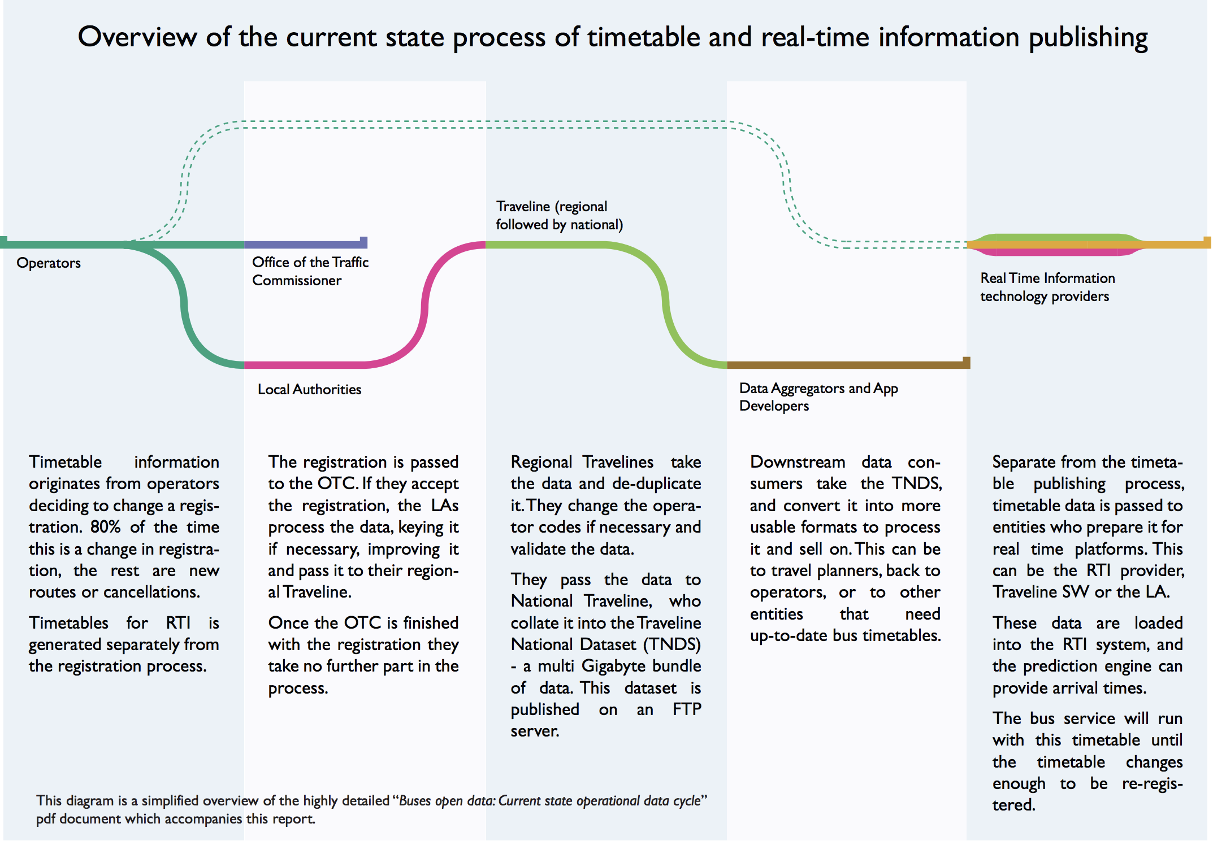
As-Is data process summary - overview
High-level process map - current state
The OTC do not contribute to improving open data quality. Where EBSR is used, OTC perform surface validation checks, but do not ensure that timetable and route information are sensible or realistic.
Short-notice or short-term updates are often not reflected in BSR or TNDS.
Real time information is not always perfectly linked to timetable information.
Large cross-regional variations in the data processes. This includes the involvement of regional/national Traveline, the level of engagement from LAs and the responsibilities for entering and validating the data between operators and LAs.
Lack of integration between datasets and Different update cycles for different datasets.

Slide 11
Open data exemplars framework
Open data initiatives take a range of approaches which can be understood using this model.
Open data initiatives can take many forms and have many facets. To understand each of the initiatives we use a generalised high-level model for describing the approach taken by each initiative.
Governance – Key implementing organisations, incentives and regulation, stewardship
Data sources
Data users
(including value adding services such as analytics and AI)
End users
Publishing
Hosting – where data is hosted and how it is transferred
Licensing – what licence is placed on the data
Training – what training helps users publish data
Tools – what tools are available to help data publication
Standards – what standards are adhered to or required
Access
Access mechanisms – how data is provided, e.g. downloads, API
Enabling discovery – how data can be found, e.g. catalogue
Feedback mechanisms – how users can contact publishers
Encouraging innovation – what is done to encourage use

Slide 12
Recommendations

Slide 13
Recommendations summary
We have provided 8 recommendations to drive forward Bus Open Data
DfT should re-build its data leadership to guide the bus sector towards better data sharing. These efforts should include:
  Establish a dedicated DfT data function and implementation group. DfT should guide the market towards better and open data. To do so, it needs to establish a Bus Data Team and work closely with the industry.
  Enable a decentralised publishing model: Data should be published as close to the source as possible to realise its potential. Data would be made available through a discovery portal.
  Develop tools and training: To support the distributed model, DfT would develop basic tools and training to increase operators’ skills and capabilities and enable them to publish their own data.
  Incentivise good quality data: DfT to re-design registration objectives and fees, including EBSR, incentivise good data quality through BSOG and punctuality scoring.
  Define a phased data requirements implementation plan: DfT to lead an organic and phased implementation plan, to accommodate regional variances and different sizes and types of operators.
  Transform the registration process to optimise open data: Bus registration should support good data practice, and should be separated from open data requirements. Compliance data should be derived from open data as much as possible.
  Better communicate the benefits of open data.
  Establish a data innovation fund: DfT should establish a data innovation fund focused on solving industry challenges with data.

