Slide 1
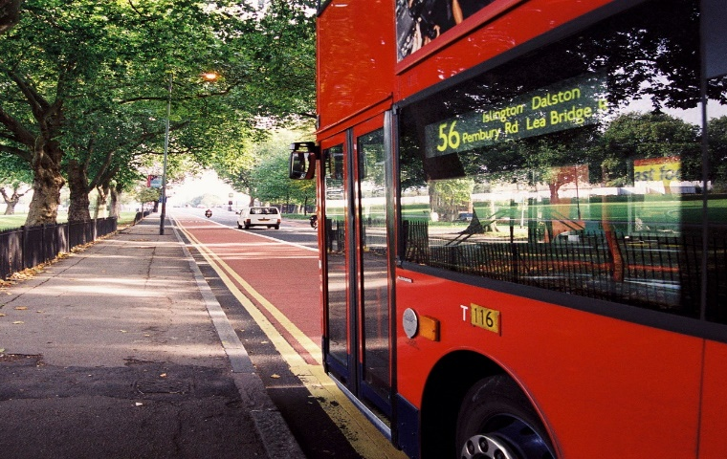
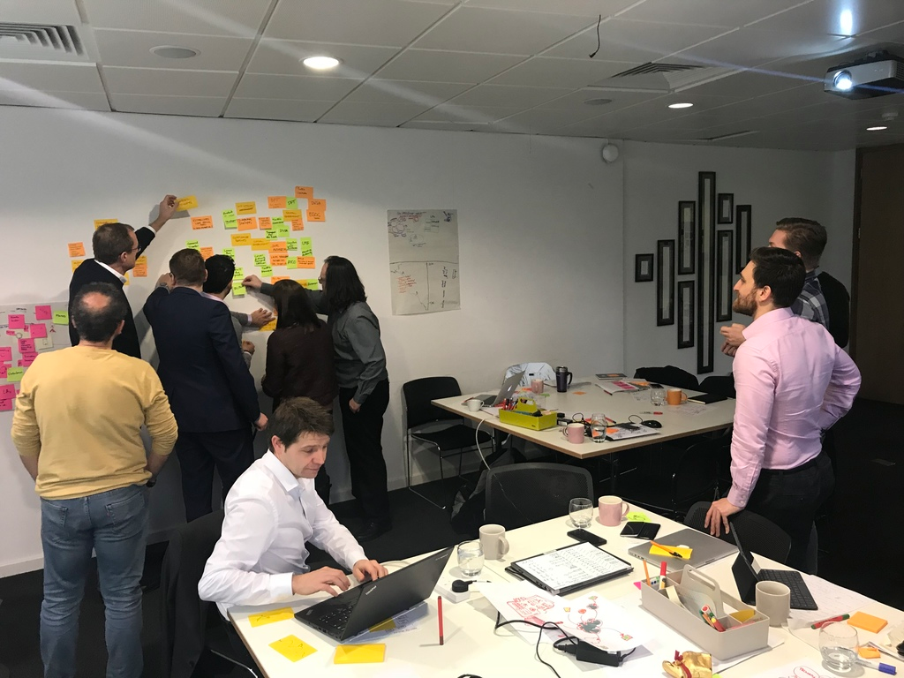
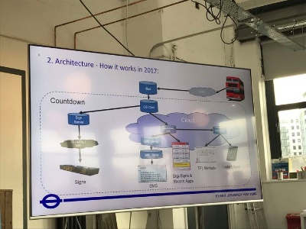

DRAFT – FOR DISCUSSION
Bus Open Data – Stakeholder map
Inputs: Identifying and validating stakeholders
All Aboard sessions:
  London.
  Birmingham.
  Leeds.
  Over 50 attendees in each session.
Stakeholder mapping session:
  Detailed identification of gaps in the market, research questions
  and stakeholder groups.
Field visits:
  Preparation for Phase 2: visits to TrentBarton, Arriva Click.
  Discussions with Traveline.
Meetings with DfT stakeholders:
  Futures, Buses & Taxis team.

Slide 2
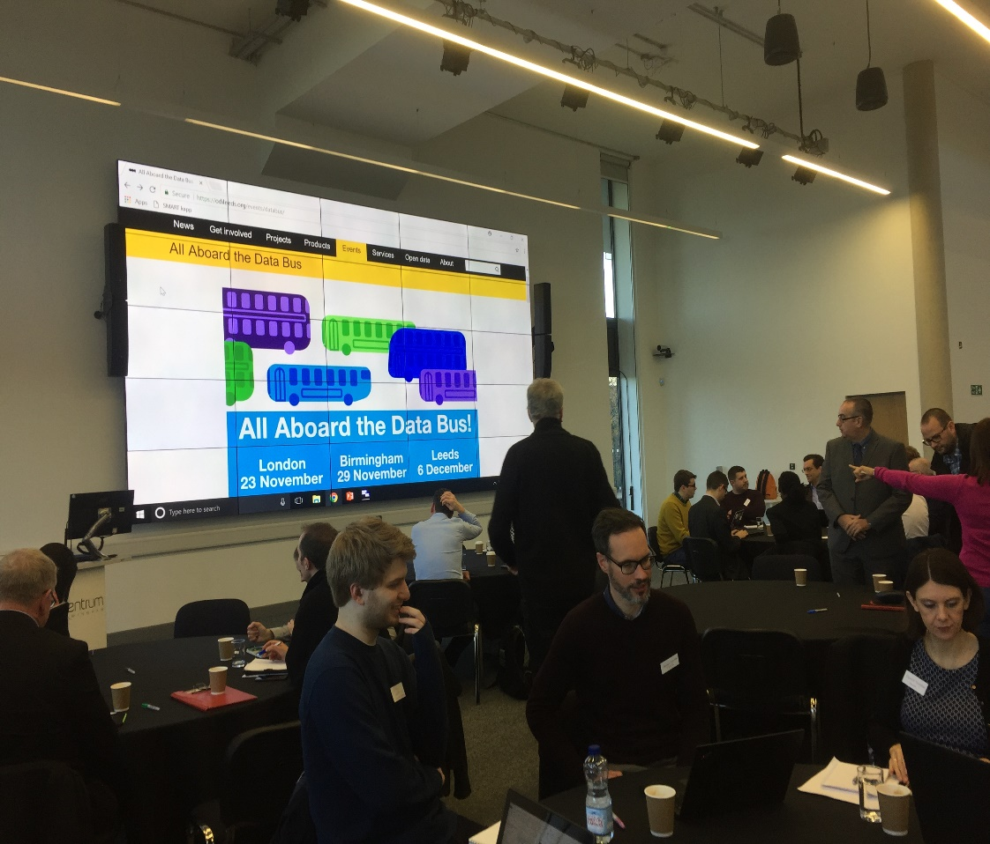
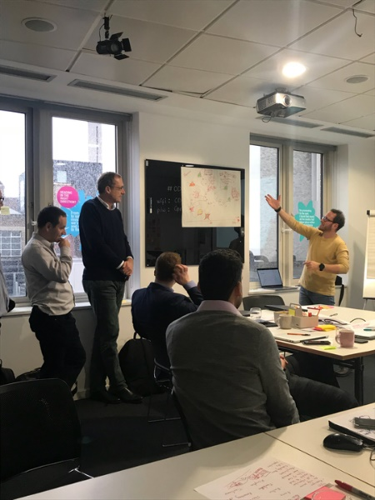
DRAFT – FOR DISCUSSION
Bus Open Data – Stakeholder map
Inputs: Wide industry participation

Slide 3
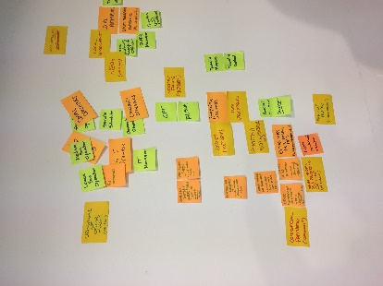
DRAFT – FOR DISCUSSION
Bus Open Data – Stakeholder map
Output: Stakeholder groups
Based on our workshops, we identified 7 stakeholder groups and started engaging with a few representatives of each group:
Stakeholder map
Group |  | Sub-groups | Selected Representatives
 | Transport Operators | Big 5 | Big-5 operators
 |  | Medium operators | Reading Buses, Trentbarton
 |  | Small operators | Ensign Bus, Stephensons of Essex, ALBUM
 |  | ‘Future’ on-demand operators | Arriva Click, Slide
 | Local authorities & LTAs | Local authorities | Norfolk County Council, West Yorkshire Combined Authority
 |  | Local transport authorities | TfN, TfL, TfWM, Merseytravel
 | Central government and regulators | Regulators | CMA, Government Digital Service, TCs
 |  | Department for Transport | Bus Service Operator Grant (BSOG), DfT Digital, Traffic Commissioners (TC)

Slide 4
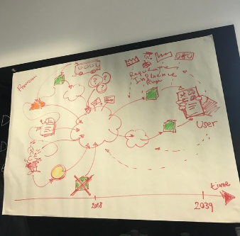
DRAFT – FOR DISCUSSION
Bus Open Data – Stakeholder map
Output: Stakeholder groups
Stakeholder map
Group |  | Sub-groups | Selected Representatives
 | Bus Technology providers | Technology providers | Omnibus, Trapeze
 | Data technology stakeholders | Data aggregators | ITO World, TransportAPI
 |  | ‘Downstream’ data users | Google Maps, Citymapper, independent developers
 | End users | Transport users advocacy groups | Transport Focus, Bus Users UK
 |  | Users with special needs | Disabled Persons Transport Advisory Committee
 | Think-tanks and industry groups | Think-tanks | Transport Systems Catapult
 |  | Industry groups | ATCO, CPT, RTIG, PTIC

Slide 5
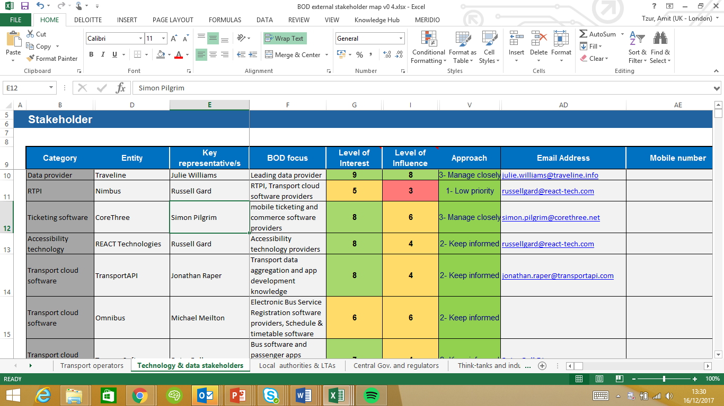
DRAFT – FOR DISCUSSION
Bus Open Data – Stakeholder map
Output: Stakeholder matrix
A detailed stakeholder matrix captures the entities and stakeholders in each stakeholder groups, including interest & influence score, sentiments & thoughts and next actions.
The stakeholder matrix can be found here - BOD stakeholder matrix

Slide 6
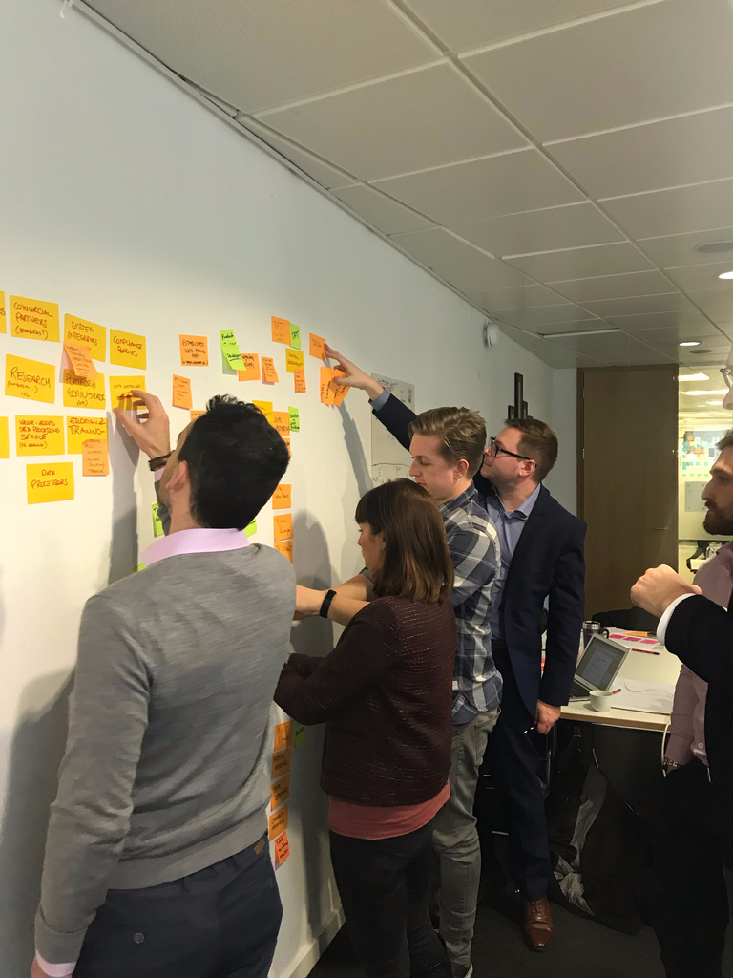
DRAFT – FOR DISCUSSION
Bus Open Data – Phase 2
Outcome: stakeholder engagement plan
During phase 2 of the Discovery Phase, we will spend three weeks meeting representatives of the stakeholder groups across the country.
Partial list of stakeholders and geographical locations appears below:
Local Authorities
Essex County Council
Norfolk County Council
West Yorkshire Combined Authority
Lincolnshire County Council
Local Transport Authorities
Transport for Greater Manchester
Transport for the North
Transport for West-Midlands
Transport for London
End Users
Transport Focus
Bus Users UK
“
When you need to innovate, you need collaboration
Marissa Mayer
Bus Operators
Arriva Bus
First Bus
Go Ahead Group
National Express
Stagecoach
TrentBarton
Ensign Bus
Reading Buses
Oxford Bus Company
Yellow Buses
Newcastle
“
Leeds
Manchester
Liverpool
Bus Technology providers
Trapeze
Omnibus
Ticketer
CoreThree
Data technology stakeholders
ITO World
Traveline
TransportAPI
Google Maps
CityMapper
Whim
Nottingham
Birmingham
Milton Keynes
Cambridge
Oxford
St Albans
Think-tanks and industry groups
Transport Systems Catapult
Association of Transport Coordinating Officers
Confederation of Passenger Transport UK (CPT)
Bristol
Reading
London
Bath
Southampton
Bournemouth
Note: We will continue to update the stakeholder engagement plan in Phase 2

Slide 7
Phase 2 meetings and contextual enquiries
DRAFT – FOR DISCUSSION
Bus Open Data – Phase 2
Overview of the current Phase 2 calendar (Jan 02- Jan 19) can be found below:
January 2018
 | 1st | 2nd | 3rd | 4th | 5th
AM | New Years Day | Slide Bristol AT, | Lincolnshire Council | National Express | South West Public Transport Information
PM |  |  |  | TfWM Stage Coach Transport Focus
 | 8th | 9th | 10th | 11th | 12th
AM | Trent-Barton Transport API | Essex County Council |  | Oxford Bus Company
PM |  | Ensign Bus Essex | Bus Open Data Prog. Board
 | 15th | 16th | 17th | 18th | 19th
AM | West Yorkshire Comb. Authority | Norfolk County Council | TfL ITO World
PM |  |  |  | Yellow Buses | ATCO
Transport Operators
Local authorities & LTAs
Central government and
regulators
Bus Technology providers
Data Groups
End Users
Think-Tanks and Industry Groups
3 validation workshops will be held in Phase 3
Note: We will continue to update the stakeholder engagement plan in Phase 2

Slide 8
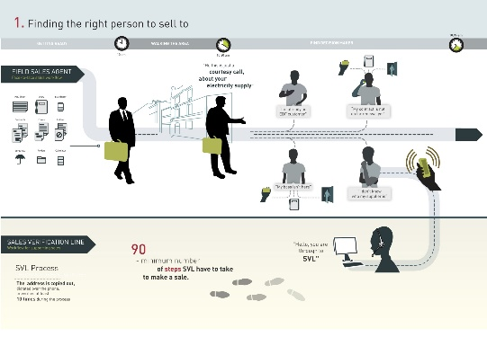
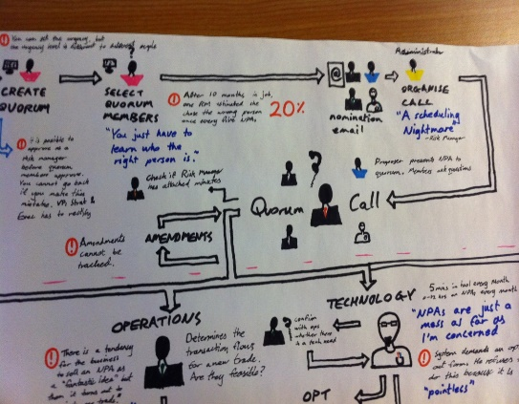
Expected outputs
DRAFT – FOR DISCUSSION
Bus Open Data – Phase 2
Phase 2 meetings and contextual enquiries will enable us to identify stakeholders’ perspectives and requirements. By the end of Phase 2, we will produce:
User personas and profiles:
  Detailed user personas and profiles of the key stakeholders, including bus operators, local authorities, technology providers, data aggregators and end-users.
High level process maps:
  L1 and some L2 process maps of the key as-is processes.
  Suggested L1 process maps of the to-be process.

Slide 9

Open data definition and key requirements
DRAFT – FOR DISCUSSION
Bus Open Data – solution considerations
Definition: Open data is data that anyone can access, use and share.
Key requirements:
Open licence
  A licence confers rights to users and gives them confidence to use and re-share data.
  An open licence must guarantee anyone the ability to use, redistribute and modify data in any way.
  An open licence may require users to attribute the source and to also publish their derivative works openly.
  An open licence should be compatible with other open licences.
Access
  Data should be made available (published) via the web for download without charge.
Machine readable
  Data must be provided in a form readily processable by a computer and where the individual elements of the work can be easily accessed and modified.
Open format
  Data should be made available in an open format is one which places no restrictions, monetary or otherwise, upon its use and can be fully processed with at least one free/libre/open-source software tool.
Full requirements for open data is provided by the open definition.

Slide 10
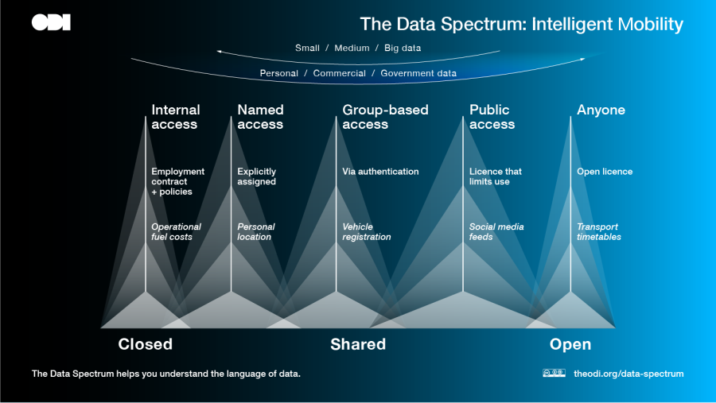
The data spectrum
DRAFT – FOR DISCUSSION
Bus Open Data – solution considerations

Slide 11
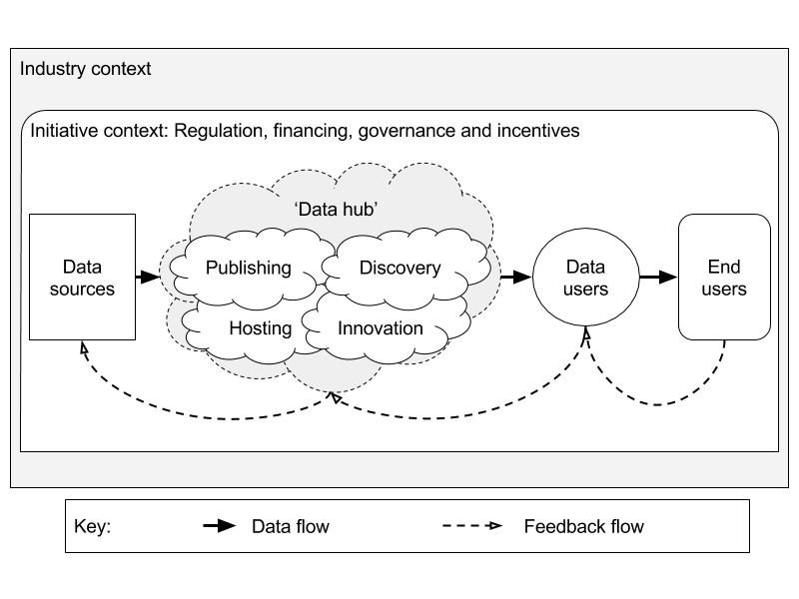
The role of open data hubs in sector ecosystem
DRAFT – FOR DISCUSSION
Bus Open Data – solution considerations
Data hubs need to take into account the following ecosystem elements:
Existing models of ecosystems/hubs:
Centralised
  E.g RDG Darwin, TfL API
Hybrid
  E.g OpenActive
Distributed
  E.g. Open Banking
Data hub characteristics:
Publishing
  Hosting
  Licensing
  Training
  Tools
  Standards
Access
  Access mechanisms
  Enabling discovery
  Certification
  Feedback mechanisms
  Encouraging innovation
  Value added services

