Slide 1
Telematics applications for passengers (TAP TSI)
UK industry meeting - Action A specifications
Nottingham, 16/02/2016
Stefan JUGELT

Slide 2
Content of this presentation
Legal framework for TAP TSI
Standardisation
Telematics applications for passenger services (TAP TSI)
Functionalities
Example: Technical documents for timetable data
Example: Connections with other modes of transport
Questions and Answers

Slide 3
The “jargon” used in this presentation
Abbreviation | Title
CEN | European Normalization Committee
CI | Common Interface
EC | European Commission
ERA | European Railway Agency
IM | Infrastructure Manager
LRU | Lead railway undertaking
PRM | Passengers with Reduced Mobility
RISC | Railway Interoperability and Safety Committee
RU | Railway Undertaking
TAF TSI | Telematics Applications for Freight - Technical Specifications for Interoperability
TAP TSI | Telematics Applications for Passengers – Technical Specifications for Interoperability
TD | Technical Document of the European Railway Agency

Slide 4
European legal framework for rail legislation

Slide 5
European Rail Legislation for TAP TSI
The “Telematics applications for passenger services (TAP TSI)” is based on the following legal documents:
Directive 2008/57/EC on the interoperability of trans-European rail system (Annex II)
European Rail Passengers’ Rights Regulation EC/1371/2007 (Art 10 and Annex II).
→ Above documents are publicly available at the EU web site
http://eur-lex.europa.eu/en/index.htm.
Affected parties:
Railway undertakings, infrastructure managers, ticket vendors

Slide 6
European Rail Legislation for TAP TSI
e.g. passenger information Passenger rights regulation EC/1371/2007 – Annex II:
Part I: Pre-journey information
General conditions applicable to the contract
Time schedules and conditions for the fastest trip
Time schedules and conditions for the lowest fares
Accessibility, access conditions and availability on board of facilities for disabled persons and persons with reduced mobility
Accessibility and access conditions for bicycles
Availability of seats in smoking and non-smoking, first and second class as well as couchettes and sleeping carriages
Any activities likely to disrupt or delay services
Availability of on-board services
Procedures for reclaiming lost luggage
Procedures for the submission of complaints.
Part II: Information during the journey
On-board services
Next station
Delays
Main connecting services
Security and safety issues.

Slide 7

The railway standardisation pyramid
1.Safety
2.Reliability and availability
3.Health
4.Environmental protection
5.Technical compatibility
6.Accessibility
Interoperability Directive
6 Essential Requirements
Mandatory Rules
TSIs + NNTRs
Mandatory
Specified in
TSIs / NNTRs
(OTIF Rules)
•
Level of DETAIL
Standards directly
quoted in TSIs,
Technical documents
EN’s
ISO
Harmonised
EN Standards
Other public standards and documents
Voluntary
•
Applicant chooses
own specification
UIC
Company standards

Slide 8
Standards vs. Legislation
Legislation :
Mandatory
Established by public authorities
Revised when legislators so decide
May refer to a change control process for annexes (e.g. CCS TSI, TAF/TAP TSI)
Gives requirements to protect public interests
Can make reference to standards (which then become mandatory)
Harmonisation foundation (New Approach Directives, removal of barriers to trade)
Standards :
Voluntary (unless otherwise specified in legislation)
Consensus of stakeholders
Developed by independent private organisations
Revised regularly (~every 5 years)
Provide usually technical specifications and test methods (interoperability, safety, quality, management, etc.)
Harmonisation tools (harmonised standards)

Slide 9
Telematics applications for passenger services (TAP TSI)

Slide 10
Purpose of TAP TSI
The Technical Specification for Interoperability on “Telematics Applications for Passengers” (TAP TSI) prescribes protocols for the data exchange of:
timetables,
tariffs,
reservations, fulfillment
Information to passengers in station and vehicle area
train running information,
Etc.
which must be respected by the European rail sector (railways, infrastructure managers, ticket vendors etc.) according to the European Rail Passengers’ Rights Regulation EC/1371/2007 and to the Interoperability Directive EC/2008/57.

Slide 11
Technical Documents of TAP TSI
In Dec 2009 ERA has signed contract with UIC according to which UIC has transferred the underpinning UIC leaflets as ERA Technical Documents:
B.1, B.2, B.3 (tariff)
B.4 (timetable)
B.5 (reservation)
B.6, B.7 (ticketing)
B.8, B.9 (reference data)
B.10 (reservation for PRM assistance)
Above ERA Technical Documents are annexes of the TAP TSI, thus, legally binding.
All Technical Documents are available at ERA’s website at http://www.era.europa.eu/Document-Register/Pages/TAP-TSI.aspx .
The technical documents are maintained by ERA through a change control management process. UIC is involved in this process.

Slide 12


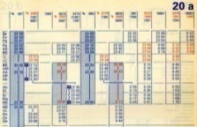

Example: TAP TSI – timetable data exchange
Purpose:
Exchange of timetable data
Conditions:
Annual timetable must be published at least two months before entering into force
Timetable changes must be published at least 7 days in advance
How:
File in EDIFACT-format (technical document B.4)
RU’s website
RU
Other RU’s
Authorities and 3rd parties

Slide 13



Connections with other modes of transport
Purpose:
Exchange of network, timetable and real-time data
From railway to other transport modes, but not vice-versa
Conditions:
No bidirectional exchange!
How:
Current:
EN 12896 (‘Transmodel’) and EN TC 278 WI 00278207 (IFOPT) for network and timetable data
EN 15531 (‘SIRI’) for the exchange of real-time data
Future:
timetable and tariff data exchange based on NeTEx
RU
Other transport modes

Slide 14
Transmodel and TAP TSI timetable
Organisations
StopPlaces
VehicleJourneys

Slide 15
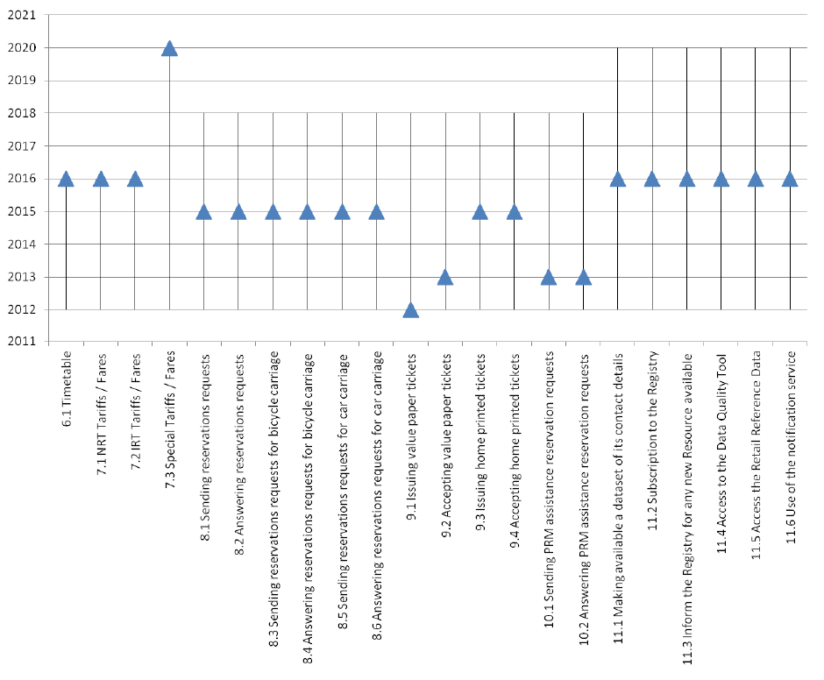
Implementation of TAP TSI
Retail – functions:
The master plan define the implementation dates for the functionalities of the TAP TSI (retail and RU/IM-communication)

Slide 16
Questions?

Slide 18
Backup

Slide 19
Example: TAP TSI - timetable data
Example:
EC 90 provides a restaurant (code 9).
The train runs from MILANO (008301700) via BERN (008507000) and STRASBOURG (008721202) to LUXEMBOURG (008200100).
Bicycle transport (code 26) is available only from BERN (stop index 2) to LUXEMBOURG (stop index 4).
PRD+00090:::37:::Vauban+0083**0085’
POP+273:2003-12-15/2003-12-20::111111’
PDT++:::50’
SER+9’
POR+008301700:37:12+*0810’
POR+008507000:37:12+1156*1204’
POR+008721202:37:12+1444*1446’
POR+008200100:37:12+1650’
ODI+008507000*008200100+2*4’
SER+26’

Slide 20
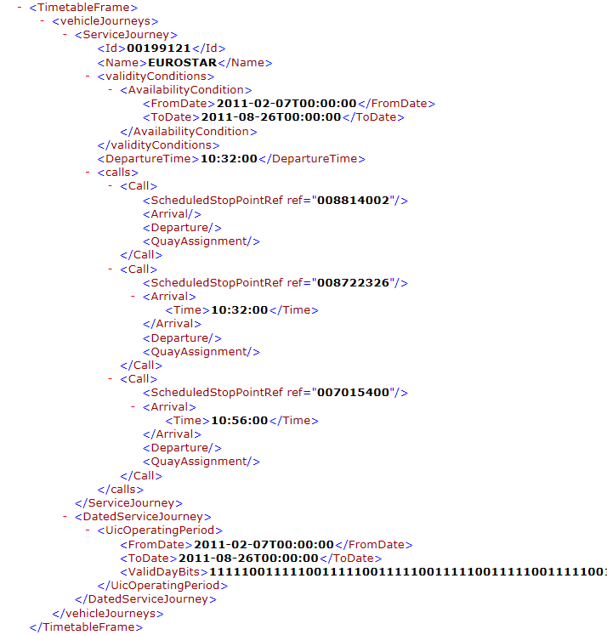
NeTEx-Structure - Example
Example on a so called vehicle journey (journey undertaken by a vehicle to carry passengers) for a Eurostar train running between London and Paris
Shows:
Journey name
Timing points (e.g. stops, passing in a station)
Operating days (validity period + Service calendar as bitmap)

