Slide 1
SIRI Changes
Tim Rivett
For PTIC 8th October 2019

Slide 2
GIT
‘Official’ GIT repository
https://github.com/SIRI-CEN/SIRI

Slide 3
Issues & Change Requests
Two options:
  Textual with an issue: https://github.com/SIRI-CEN/SIRI/issues
  Full formalized xsd change as a pull request

Slide 4
Minor releases and major releases
After a given number of change requests a new version is formed.
Minor releases will be shown with a new letter (e.g. v2.0o). This should be non-breaking changes.
A version number in the second number is still minor. There should mainly be extensions and things that can easily adapted like enum (e.g. v.2.1a)
A major release with a new version (e.g. v3.0a) contains breaking changes.

Slide 5
Documentation and the xsd
For copyright reasons the full standards document can not be put on GIT
All changes in the XSD also to be in the document at the same time.
This means that a pull request is only merged, when the document(s) are updated.

Slide 6
TPEG / DATEX & NeTEx
Hard link between SIRI and TPEG and DATEX.
  TPEG & DATEX latest updates not backwardly compatible
  Implementation challenges with SIRI.
  Remove hard links
NeTEx
  Table enumerations
Throw away codes & use names

Slide 7
Misc. Changes
Adding filters to subscriptions
  Receive less data
  More targeted
Subscription renewal improvement
Multilingual support
  Currently inconsistent application
  Important for UK: Welsh language
Increased Mode types
Consistency in Arrival – Departure information at Stop
Support for Service Branding

Slide 8
European Profile

Slide 9
Background
The Commission Delegated Regulation (EU) 2017/1926 requires SIRI to be used on National Access Points to provide dynamic Public Transport information.
National SIRI profile should be based on a Minimum European SIRI Profile
Norway, France and Germany have national SIRI profiles
SIRI European Profile is expected to be as simple as possible and to focus on Passenger Information.

Slide 10
Profile Objectives
Estimated departure and arrival times of services
Disruptions
Real-time status information — delays, cancellations, guaranteed connections monitoring
Status of access node features (including dynamic platform information, operational lifts/escalators, closed entrances and exit locations — all scheduled modes)
Covering the needs of rail identified in the TAP-TSI
Consistency with NeTEx EPIP

Slide 11
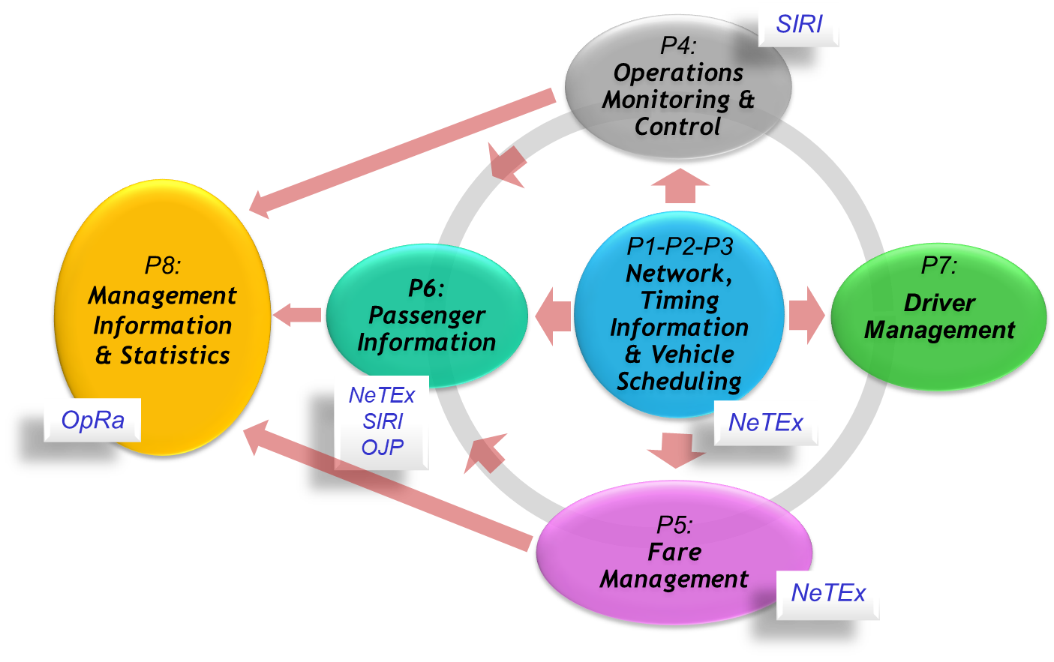
Transmodel domains

Slide 12










NeTEx is for static data
(SIRI is for real-time data)
FSM etc
Retail API
Fare Products & Prices BASELINE PROVISIONING
Booking Systems
Formats
STATIC DATA
Trip Planning API
DJP
Timetables STATIC DATA BUILD
Trip Planner Engines
Realtime Operations
BASELINE PROVISIONING
Real-time API
Data must fit together via any route!
Real Time Feeds
Real-Time
Prediction Engines
SIRI-xx
Protocols

Slide 13
Plan
12 month programme ending December 2020.
to collect and analyse the national feedback from first SIRI usages and profile definitions,
to collect the requirements of ERA – TAP/TSI and UIC,
Collect inputs from the priority action A of the ITS directive and associate studies,
Ascertain the detailed functional scope of the profile,
To produce the profile document itself,
To produce the conformance and quality checking rules.

Slide 14
UK Profile
European profile important
  Suppliers are pan Europe / world
Simpler UK profile creation
  Many interpretations
Bus Open Data will require simple location information profile.

