Slide 1
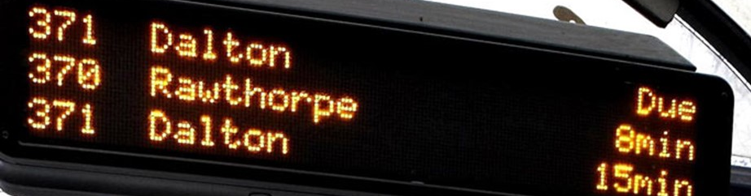
TransXChange: Public Transport Information Profile
Final Proposals

Slide 2
Introduction

Slide 3
Aim of the TransXChange PTI Profile
67.2%
Perception that TXC is too complicated, with too many different ways of encoding the same data
⇒ errors in creation and/or interpretation
Aim, therefore, is to create a simplified profile which will be used consistently by all systems / operators.
Clear, unambiguous data, backed up by simpler, focussed, guidance.
More readily understood by downstream open data users.
Higher take-up ⇒ better applications.
Easier diagnostics / fault finding.
Business case for change and proposed changes validated by survey.

Slide 4
Drivers for change
56% of users agreed or strongly agreed that TXC was hard to interpret
74% of users agreed or strongly agreed that there are too many different ways of writing the same thing in TXC
A huge 92% of users agreed or strongly agreed that standardising the way that TXC is written is a positive thing to do
Conversely, only 8% of users agreed (and none strongly) that TXC was fine is it is.
Note, though, that 67% of users also either agreed or strongly agreed that “changes to TXC must not add cost to my business”
Notes:
The BODDS programme requires TXC data, but there was a perception that TXC data was too complicated and that there were too many ways of writing the same data.

Slide 5
Survey : Business case for change / proposed changes
76 completed responses
21 regional / local or national government
13 transport authorities
28 public transport operators
7 suppliers
7 others (including consultants and users)

Slide 6
Survey : The audience
There is (perhaps unsurprisingly) a lack of knowledge around the standards.
NaPTAN is the most familiar (>70% have some degree of familiarity with it, increasing to >90% if include use in scheduling systems)
A significant number (nearly 50%) have no or very little awareness of NOC

Slide 7
Survey : The audience (broken down)

Slide 8
Final PTI Profile Proposals
Proposals which were in the consultation
Notes:
The principle is to try and tidy up and clarify the way that TXC is completed, rather than aim for a fundamental shift in meaning.

Slide 9
Survey : Operators
Broad agreement with the proposals, with >50% agreeing or strongly agreeing across most questions
However:
I feel it is inadvisable to allow operators to maintain their own data, and the database should be moderated
NOC probably needs to be part of BOD so there is one joined up place for Operators to understand
I think it may be unrealistic to expect smaller operators to maintain this data to the necessary quality.
Where does the responsibility sit? It's not seen as a priority for operators to maintain.
The legal name of a bus operator (i.e., that shown on the O licence and on the legal lettering on vehicles) may be important
Notes:
Re: the last recommendation on NOC, it is not fair to ask TIL to be responsible for maintaining and continually updating all of the operators. A revised front end is essential to allow this to happen (perhaps with DfT financial assistance as it will be a key part of the PTI data).
At the same time, status (e.g. “active”, “deleted”) and versioning (date modified, etc) is essential to track changes and revert, if required, to a previous state. Finally, a “tidy up” is long overdue.

Slide 10
Final proposals : Operators
A file shall contain only one operator.
The use of the NationalOperatorCode element is mandated.
OperatorCode is not required but may be populated for compatibility with historic systems.
Clearly, there is work to be done to better socialise NOC among operators
NOC needs some work.
Who maintains NOC? ⇒ policy decision
OperatorShortName is mandated by the schema and shall match the “Operator Public Name” given in NOC.
Can only have 24 characters, though. Problem for e.g. Nottingham City Transport (25) and others
TradingName, where different to OperatorShortName, shall be provided.
TradingName should also be used to hold operator names that are >24 characters
Notes:
OperatorShortName is mandated by the schema, but it only permits a maximum of 24 characters. “Nottingham City Transport”, for example, is 25. There aren’t many other naming possibilities – OperatorNameOnLicence should really be used for the legal name. For NCT this is “Nottingham City Transport Ltd” but other companies will be quite different. Other option is “Trading Name”. Again, this is a good fit here, but isn’t always the case. Ideally, names are for reference purposes only and all meaningful names are given via the NOC and perhaps in combination with LicenceNumber. This also means that, to an extent, an operator may have to “make up” a short name. The schema technically allows the OperatorShortName to be unpopulated (blank), but this is not recommended.

Slide 11
Final proposals : Operators
LicenceNumber shall be provided, in order to link operator to legal entity (either via NOC or otherwise).
OperatorNameOnLicence can be included in the TXC for reference but is better identified from other sources using the LicenceNumber
Customer contact information shall be taken from fields in the NOC database, a “single source of truth” and not included in the TXC.
<Operators> <Operator id="O1"> <NationalOperatorCode>NCTR</NationalOperatorCode> <OperatorShortName>NCT</OperatorShortName> <TradingName>Nottingham City Transport</TradingName> <LicenceNumber>PB0002362</LicenceNumber> </Operator> </Operators>

Slide 12
Survey : Services and lines

Slide 13
Survey : Services and lines
Very little disagreement with these proposals, with <10% disagreeing with any proposal and none strongly.
However:
Some EBSRs may contain more than one timetable, (e.g. seasonal services). If classed as distinct variations this would put the profile out of step with the registration process.
Keeping Line IDs as actual Unique ID format keeps the field length short, and assists when loading the data into a database
There should be the possibility for jointly operated services to be shown to the public as a single service.
How will stability of Line id be addressed? For example, a service may begin terminating in an earlier locality. The Line id would change but it'd still be the same service.
Having more that one Line per Service may lead to a greater likelihood of Lines continuing to exist in downstream systems after they have actually been cancelled or renumbered

Slide 14
Final proposals : Services and lines
A TXC document shall be permitted to hold more than one line e.g. 1/1A in order to be flexible for the operator and system generating the file. Lines should be spatially related, however.
One single Service element with multiple Line elements is preferred.
For multi-operator routes (e.g. commercial / tendered) use Service/ToBeMarketedWith and the Description field to refer to the (external) line ID
ServiceCode shall be unique for the group of lines
It shall not include a version number
It can be of any format, but must remain consistent between versions
It may be helpful for this to be the TAN registration number (e.g. PF0000459-140, replacing “/” with “-”)
A line shall have a unique ID which comprises:
The most granular NOC for the operator (e.g. FESX for First Group’s bus operations in Essex)
The ServiceCode (to assist in linking to other lines in the same group of lines)
The line Name
The reference shall not include the version number

Slide 15
Final proposals : Unique line reference examples
<Service RevisionNumber="1"> <ServiceCode>BAS08</ServiceCode> <Lines>
<Line id="FESX_BAS08_8">
<LineName>8</LineName>
</Line>
<Lines>
...
<RegisteredOperatorRef>FESX</RegisteredOperatorRef>
...
</Services>
<Service RevisionNumber=”4"> <ServiceCode>CLAC08</ServiceCode> <Lines>
<Line id="FESX_CLAC08_8">
<LineName>8</LineName>
</Line>
<Lines>
...
<RegisteredOperatorRef>FESX</RegisteredOperatorRef>
...
</Services>

Slide 16
Final proposals : Services version numbering
Services shall be given version numbers using the RevisionNumber attribute of Service.
Lines may also have versions numbers using the RevisionNumber attribute of Line, but this isn’t required.
Two versions of the same service shall never appear in the same TXC document, as this would require duplication of keys.
If an operator wants to have separate timetables for the same line (e.g. seasonal) in the same version, then these can be:
One service / two lines, with unique line ids extended appropriately (consistent between versions)
A single line, with VehicleJourneys encoded to the right operating dates.
Versions should ideally align with registration version numbers
<Service RevisionNumber="1"> <ServiceCode>BAS08</ServiceCode> <Lines>
<Line id="FESX_BAS08_8">
<LineName>8</LineName>
</Line>
<Lines>
...
<RegisteredOperatorRef>FESX</RegisteredOperatorRef>
...
</Services>
<Service RevisionNumber=”4"> <ServiceCode>CLAC08</ServiceCode> <Lines>
<Line id="FESX_CLAC08_8">
<LineName>8</LineName>
</Line>
<Lines>
...
<RegisteredOperatorRef>FESX</RegisteredOperatorRef>
...
</Services>

Slide 17
Final proposals : Direction flags and line descriptions
Direction of a particular JourneyPattern shall be defined in StandardService/JourneyPattern, and not elsewhere.
Each Line shall have an OutboundDescription and/or an InboundDescription that describes each direction of the service for public consumption. For example, “Oxford – Milton Keynes – Bedford – Cambridge” and “Cambridge – Bedford – Milton Keynes – Oxford”.
Direction enumeration clockwise shall map to OutboundDescription and anti-clockwise to InboundDescription
Other description elements shall be omitted where permitted. In particular, Service/Description is used for registrations and does not contain public-facing information.

Slide 18
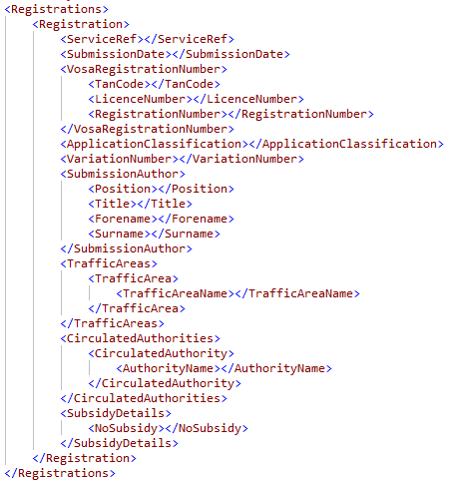
Final proposals : Links to legacy systems
There is merit in allowing BOD TXC data to link to legacy systems, and in particular to OTC Registration numbers, for checking & comparison
Using the Registrations block is not recommended, however, because it contains significant extraneous, inappropriate information (see image)
Suggest using Service/PrivateCode to hold the registration reference instead.

Slide 19
Final proposal : Other aspects of services and lines
To minimise over-ridden data, OperatingProfile shall not be used in Service but shall be declared in full in each VehicleJourney
The PublicUse flag shall be used on services which are not open to the general public but have some restriction e.g. school services requiring passes.
Registration information, such as ServiceClassification, StopRequirements and CommercialBasis is of little use in passenger information and is not required in Service.
Each standard bus service shall have a StandardService element.
There shall be as many JourneyPattern elements as required to fully represent the different patterns of operation.
It is recommended that JourneyPatterns are broken down into reusable JourneyPatternSections which can be joined together with multiple JourneyPatternSectionRefs.

Slide 20
Survey : Stops

Slide 21
Survey : Stops
Clear desire to see appropriate NaPTAN references being used (~95%) and descriptors being taken from NaPTAN (90%)
Fairly equal split, however, on allowing operators to declare their own stops
Worried that operators will create stops in unsafe locations.
If the correct code is used Operators should be able to include their own names for readability / local systems. Downstream users will take the official name from NaPTAN
Operators need to be able to define a stop due to the time it takes for NaPTAN to be updated
We occasionally use dummy stops in our data to improve real-time tracking
Some specialist services only run on one or two days per year. To setup a NaPTAN point for these would not be cost effective
The use of NaPTAN can prove restrictive, particularly where the stop details are no longer relevant to current operations or service routings.
Avoid the wild west - it will end up diluting the quality of NaPTAN
Notes:
Bubble (1)– Some authorities were specifically named as being “bad” at keeping data up to date or responding in a timely manner
Equal split regarding stops from operators, although heavily weighted towards acceptance by operators and rejection by authorities.
Comment about “stop details no longer relevant to current operations” came from a Scottish operator.

Slide 22
Final proposals : Stops
AnnotatedStopRef elements are mandated when there is an appropriate, active stop in NaPTAN;
A StopPoint element may be used:
if a stop is not in NaPTAN and there is no prospect of it being in NaPTAN within an appropriate time frame. It shall be replaced by an AnnotatedStopRef as soon as one becomes available ⇒ policy decision
for temporary stop point e.g. roadworks, festivals, etc;
for non-access stop points e.g. tracking points, announcement points, etc;
CommonName, Indicator, LocalityName and LocalityQualifier, if present, are for readability only – the actual values shall be taken from NaPTAN. Other additional elements for AnnotatedStopPointRef shall not be used.
Stop points shall be appropriate to the mode, i.e. bus stops and not rail or ferry stops
Notes:
There is a very clear need to improve the quality of NaPTAN in many places, and there is also a clear need to establish a robust process for requesting and getting stop codes. It may well be best if DfT place some SLAs on local authorities using the powers in the Act.
The proposals don’t specifically mention creating stops locally for “private” services. These are generally school services, and even though they are private it is helpful to students to be able to access data on services to their schools. We should therefore encourage the adding of NaPTAN points that are private, but using the (2.4) “PublicUse” flag to denote them as private stops.

Slide 23
Survey : Routes and tracks
Fairly evenly split between two choices (45/35 agree/disagree)
Will help with EBSR development in the future
There should be no room for doubt over the specific route used by a bus service
If smaller operators are unable to achieve this, then the concept itself is flawed.
These are required to avoid an interpretation issues, particularly if a route is being used which does not have NaPTAN points
Essential for hail & ride sections of route, so passengers can be told where they can actually board and alight
Trying to get developers to use another source results in possible misinterpretation
Nice to have, but not essential.
Notes:
It isn’t clear from the question what respondents are disagreeing with (the optional nature, or the recommendation to include them) but from comments it becomes clear that those who disagree feel very strongly that tracks should be mandatory.
There was a suggestion that BODDS should provide the ability to define the tracks and add them to the TXC files.

Slide 24
Final proposals : Routes and tracks
It was widely recognised that track data is useful, although respondents felt that all operators should be brought up to the same level of capability
Track data can be generated from other sources if required (e.g. from SIRI VM data)
The proposal is that Route (and RouteSections / RouteLinks) shall be mandatory, and that Tracks will be recommended but not mandatory
Although policy should promote tracks and push operators to defining them ⇒ EBSR.
Notes:
Making Routes mandatory at this stage is a minor thing, but it enables the provision of track data later. If track data was wanted, but Routes were not present, then this becomes a bigger change.

Slide 25
Survey : Serviced organisations
Very little disagreement with proposals (<10% in most cases).
Largest disagreement was ~20% with proposal to include both working and holiday dates.
The only dates required are those where a service is scheduled to operate.
Any method for the simplification of dates is of significant benefit to all operators.
Some schools open late or close early on individual days. This will require two Serviced Organisations for the same school with different date ranges, and each will need a unique identifier.
Dates must always be placed in the Serviced Organisation rather than in a notes field.
Local authorities should define the names for Serviced Organisations in own area to ensure consistency across all operators’ services.
A Serviced Organisation needs to be have serviced days defined in a file that is maintained by the organisation (or LEA). This file will contain actual dates so if it expires NO BUSES WILL BE SHOWN.
With so many slightly different term dates and inset day arrangements it will be almost impossible to code the dates exactly. Setting up a Serviced Organisation and maintaining dates for each school is too onerous

Slide 26
Survey : Serviced organisations
Journey planners need dates when trips run, or they cannot calculate routes correctly ⇒ serviced organisations require valid date ranges
It is clear from the survey, however, that operators feel that maintaining school term dates will be unduly onerous
Individual schools (specific trips) vs LEA generic dates (congestion)
Combinations of different schools
Late starts / early finishes
Not informed
School term dates should, perhaps, be maintained externally to the TXC files
Although TXC files will, as a minimum, need to have defined an SO of the correct code (e.g. Edubase ID in England, SEED number in Scotland)
But who maintains these external files, and where is the legal obligation?
Requires DfT to produce policy (& co-ordinate with DfES?)

Slide 27
Final proposals : Serviced organisations
Having serviced organisations aids in explaining date restrictions to the travelling public (e.g. “College of West Anglia days only”), and is encouraged over simple date restrictions.
A ServicedOrganisation shall:
have a meaningful OrganisationCode (e.g. ”DerbsCC”, “SEED_8304734”, “EduB_116932);
have a name that describes the organisation (e.g. “Hermitage Academy”, “The De Montfort School”); and
define just WorkingDays dates. Holidays will be assumed to be all non-working days.
Trips shall be declared in a VehicleJourney either as DaysOfOperation | WorkingDays for operating day (e.g. schoolday) trips or DaysOfNonOperation | WorkingDays for trips when the organisation is closed (e.g. school holidays).
It is nevertheless recommended that display to the public is positive, i.e. “this trip runs when School X is closed” rather than a literal interpretation of the TXC i.e. “this trip does not run when School X is open”
Notes:
While policy in this area needs to be determined by DfT, the profile nevertheless needs to have guidance around how these are coded & used in the meantime.
I am persuaded (albeit reluctantly) by the arguments put forward in the comments sections (not least regarding the level of work that an operator needs to put in to maintain them) that having a single set of dates is simpler and less prone to errors like overlapping date ranges. This despite some 62% of respondents saying that they agreed with the proposal to have both working and holiday dates in the TXC.

Slide 28
Final proposals : Serviced organisations example
<ServicedOrganisation> <OrganisationCode>EduB_130735</OrganisationCode> <Name>Burnley College</Name>
<WorkingDays>
<DateRange>
<StartDate>2019-04-22</StartDate>
<EndDate>2019-05-03</EndDate>
</DateRange>
<DateRange>
<StartDate>2019-05-07</StartDate>
<EndDate>2019-05-24</EndDate>
</DateRange>
<DateRange>
<StartDate>2019-06-03</StartDate>
<EndDate>2019-06-28</EndDate>
</DateRange>
</WorkingDays>
</ServicedOrganisation>
<VehicleJourney SequenceNumber="1"> <PrivateCode>120MFBP03:O:1</PrivateCode> <OperatingProfile>
<RegularDayType>
<DaysOfWeek>
<MondayToFriday />
</DaysOfWeek>
</RegularDayType>
<ServicedOrganisationDayType>
<DaysOfOperation>
<WorkingDays>
<ServicedOrganisationRef>EduB_130735</ServicedOrganisationRef>
</WorkingDays>
</DaysOfOperation>
</ServicedOrganisationDayType>
<BankHolidayOperation>
<DaysOfNonOperation>
<AllBankHolidays />
</DaysOfNonOperation>
</BankHolidayOperation>
<OperatingProfile>
...
</VehicleJourney>

Slide 29
Survey : Vehicle journeys

Slide 30
Survey : Vehicle journeys
Strong support for explicit declarations (80%)
Weaker support for excluding “not” enumerations (70%) and named bank holidays (60%)
Less support for other measures (although at most only 15% active disagreement)
Do not want to export trips separately for each day of the week - Monday, Tuesday etc.
Still needs to be a way of saying a journey does not run for a specific period e.g. to cover Christmas
Systems should be able to cope with departures after midnight at 2500 etc. through to 2800 or beyond
Disagree with using PeriodicDayType for recurring trips or Bank Holidays. Just use explicit dates and let the import systems worry about what those are!
Giving the dates of operation for bank holidays provides a much simpler and clearer message for all.
Notes:
Weaker support for avoiding “not” enumerations possibly because limitations of schema not understood / conveyed in survey
Level of disagreement with PeriodicDayType proposal was surprising. “3rd Thursday” is a common construction, esp. in rural services, and dates will expire quickly whereas “3rd Thursday” is persistent.
A number of comments highlight a lack of understanding of the schema or of XML vs text. For example, in XML you cannot have a time > 23:59, it is not compliant. Equally, bank holidays as enumerations are date agnostic – it is up to the consuming system to determine when they are. Hence a moved bank holiday (May Day in 2020) is still catered for because the holiday is still May Day. If it were removed and replaced by a “VE Day” holiday then using explicit declarations is again better than groups, because that would be the only way to exclude the holiday. And a defined group cannot add a new holiday into it.
None of these proposals remove the ability to a) define a new holiday; or b) create specific date range exclusions such as Christmas.

Slide 31
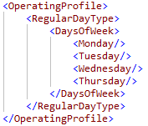
Final proposals : Vehicle journey operating profile
OperationalProfile elements shall be fully defined within the VehicleJourney and not inherit from anywhere else.
RegularDayType shall be completed so as to minimise the use of SpecialDaysOperation.
The “Not” enumerations (e.g. NotMonday) shall not be used, as there is some confusion as to their meaning in the schema.
For example, a trip that runs Monday to Thursday but does not run on a Friday:
shall be coded with each of Monday through Thursday and omit the days when it does not run.
shall not be coded MondayToFriday with SpecialDaysNonOperation to remove Thursdays. Nor should it use NotThursday.

Slide 32
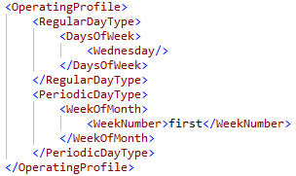
Final proposals : Vehicle journey operating profile
Journeys which operate on periodic days e.g. 1st Wednesday of each month shall use the PeriodicDayType in addition to the RegularDayType in order to define when the journey operates.
SpecialDaysOperation shall not be used to define regular periodic days.

Slide 33
Final proposals : Vehicle journey operating profile
Journeys which operate according to a serviced organisation shall use the ServicedOrganisationDayType.
“Working day” operation shall use DaysOfOperation/WorkingDays
“Holiday” operation shall use DaysOfNonOperation/WorkingDay
Dates for serviced organisations are ANDed with regular days e.g. Mondays to Fridays in a set of date ranges. This means simple ranges can be defined, and avoids having to define each Monday to Friday period separately.
<VehicleJourney SequenceNumber="1"> <PrivateCode>120MFBP03:O:1</PrivateCode> <OperatingProfile>
<RegularDayType>
<DaysOfWeek>
<MondayToFriday />
</DaysOfWeek>
</RegularDayType>
<ServicedOrganisationDayType>
<DaysOfOperation>
<WorkingDays>
<ServicedOrganisationRef>EduB_130735</ServicedOrganisationRef>
</WorkingDays>
</DaysOfOperation>
</ServicedOrganisationDayType>
<BankHolidayOperation>
<DaysOfNonOperation>
<AllBankHolidays />
</DaysOfNonOperation>
</BankHolidayOperation>
<OperatingProfile>
...
</VehicleJourney>

Slide 34
Final proposals : Vehicle journey operating profile - bank holidays
Bank holiday enumerations (e.g. SpringBank) shall be used wherever possible.
Dates are either predictable, calculatable (e.g. Easter), or published (May Day change in 2020, Royal Wedding in 2012)
Public prefer text presentation (“Does not run Easter Monday”)
All bank holidays shall be explicitly stated and “groups” (e.g. HolidayMondays) shall not be used.
Unwanted holidays are often wrapped into groups (a particular problem in Scotland)
If a holiday was cancelled and replaced by another holiday, then group would become incorrect
Additional holidays can be defined and given names and dates if required.
This may be a preferable solution for Scotland, although where a holiday retains the same name as an enumerated type then using the enumeration is better (potential duplication / confusion) or add additional info to name e.g. “Easter Public Holiday (Fife)”

Slide 35
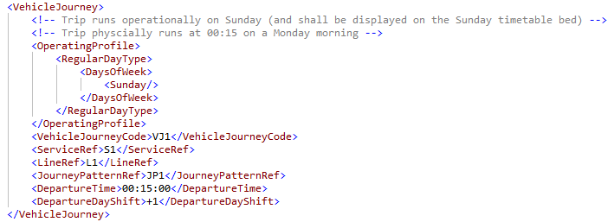
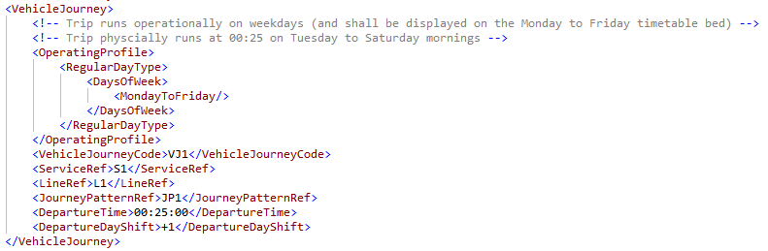
Vehicle Journeys – Journeys after midnight
Journeys which take place after midnight but which should be with the previous operational day (e.g. early Saturday morning trips on the Monday to Friday timetable) shall use of DepartureDayShift.

Slide 36
Final proposals : Vehicle journey information to support Real Time
Information to support real time information shall be included where available. This may included Garages, TicketMachine, Block, DutyCrew, etc.
In common with the principle of explicit declarations, where these are included they shall be fully declared as part of VehicleJourney elements, if possible, and nowhere else.
There is merit in including dead runs and vehicle positioning information, as this helps real time systems estimate times for following trips. However this has been known to cause confusion in downstream systems and should be avoided unless a specific need to include it.

Slide 37
Final PTI Profile Proposals
Proposals which were not in the consultation
Notes:
The principle is to try and tidy up and clarify the way that TXC is completed, rather than aim for a fundamental shift in meaning.

Slide 38
Journey Pattern Sections and Timing Links - Stops
The “to” stop of a JourneyPatternTimingLink and the “from” stop of the following link shall have exactly the same information:
StopPointRef is mandatory in the schema
TimingPointStatus and Activity shall be mandatory for the profile
WaitTime is optional, as required
DynamicDestinationDisplay is recommended, as it aids the depiction of “towards” type messages on e.g. circulars. However, use of abbreviated names shall be minimised and, where used, readily understandable.
For TimingPointStatus, TXC allows both older 2.1 enumerations (e.g. “PTP”) and newer (2.4+) enumerations (e.g. principalTimingPoint). For clarity, the newer enumerations shall be used, using only principalTimingPoint (note spelling) for timing points and otherPoint for non-timing points.

Slide 39
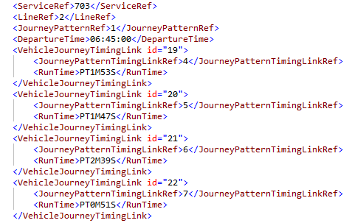
Journey Pattern Sections and Timing Links – Run Times
TXC allows many elements to have defaults, and to be over-ridden by more precise elements. This can lead to errors when merging from different places.
The profile is therefore recommending that over-riding shall be eliminated as far as possible by defining an element fully in the most appropriate place.
This implies that journey timings should be in VehicleJourneys. Cannot eliminate JourneyPatternTimingLinks though.

Slide 40
Journey Pattern Sections and Timing Links – Run Times
Profile will therefore mandate that either :
All RunTimes shall be defined within JourneyPatternTimingLinks, and no VehicleJourneyTimingLinks shall be used; or
All RunTimes in JourneyPatternTimingLinks shall be PT0M (i.e. no time), and all actual run times shall be defined within VehicleJourneyTimingLinks.
In the latter case, the list and order of VehicleJourneyTimingLinks shall match exactly the JourneyPatternTimingLinks in the referenced JourneyPattern, with a run time provided for each.
This also applies to other detail within ‘to’ and ‘from’ elements in links – if it is to be defined in VehicleJourneyTimingLinks, then all elements are to be defined there.

Slide 41
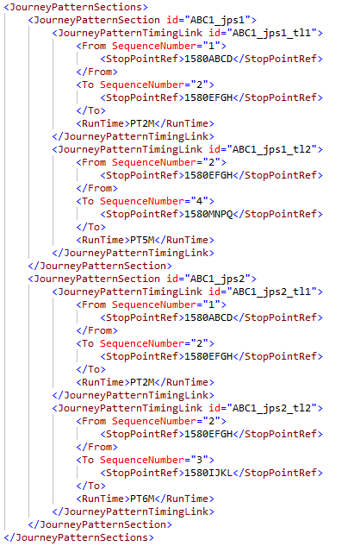
Journey Pattern Sections and Timing Links – Sequence Numbers
There is a desire for TXC files to be more helpful to publishers, to assist in making a timetable readable. It is therefore mandated that JourneyPatternTimingLink elements shall use the SequenceNumber attribute.
Seq No | Name | AtcoCode | Trip 1 | Trip 2
1 | One | 1580ABCD | 08:00 | 08:15
2 | Two | 1580EFGH | 08:02 | 08:17
3 | Three | 1580IJKL | | | 08:23
4 | Four | 1580MNQ | 08:07 | -
Notes:
Sequence numbers can also be applied to VehicleJourney elements in order to constrain how trips are ordered within a timetable bed.

Slide 42
Journey Pattern Sections and Timing Links - Other
Direction shall not be specified on the JourneyPatternTimingLink. A set of sections making up a JourneyPattern will all have a common direction, and this shall be specified in the JourneyPattern definition.
It is common practice to have a single JourneyPatternSection in any given JourneyPattern, even though this can result in multiple definitions of common parts of a timetable. It is considered good practice to define any section of route once only, and then to link these together with multiple JourneyPatternSectionRefs elements within the JourneyPattern

Slide 43
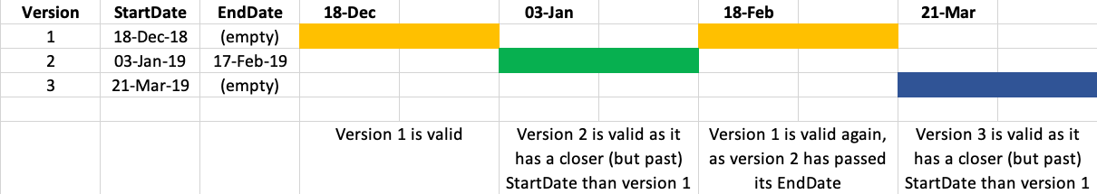
Services – Operating Period
Services that run “until further notice” shall not have an end date in the OperatingPeriod.
End dates long into the future shall be avoided, as this implies that the service ends.
It is possible that operators will publish a new version of a TXC file and forget to end-date the earlier version. In such cases, the nearest active version (in time) to a given date will be considered to be the version in operation. This is shown in the diagram below.
Nevertheless, operators should strive to publish accurately dated information
Defining how an operator should end-date services or versions of services previously submitted to BODDS without an end-date is a DfT policy decision.
Notes:
This is a stop gap solution. Operators should always publish correct data, but you can guarantee that, at some point, someone won’t.

Slide 44
Comments and Questions
Any further comments or questions, please contact
Stuart Reynolds
stuart@reynoldsconsultancy.co.uk
THANK YOU

